Slide 1
IT VISION
Future Roadmap
RAJEEV BAKSSHI

Slide 2
Vision
We aim to be very innovative, trusted, ethical which will ultimately help in achievement of organizational objective.
We are on the verge of developing new systems with latest technology which will create a strong bond between IT professionals and users. Also we have planned to release new systems so that additional information may be provided in better way and with least maintenance.
We as IT professionals look forward for continuous and effective growth of organization.
We are moving towards latest trends of providing information for timely decision making.

Slide 3
Objective
IT has been making constant endeavors for the fulfillment of the core requirements of the users but the thing that makes the difference is that, now the time needs analysis of data to a greater extent. Analysis of data is must for an organization as it helps us to know where we stand and what more efforts are required to make our workplace a profit making organization.
Our aim is not only to fulfill the requirements from various users but also to refine the processes in a better way, so that the users as well as the higher management can rely 100% on the provided systems with a lot of ease hence utilizing there time in some productive thinking. We believe in our punch line “We Stick with you, so you don't get stuck........”
We are always determined to provide our best as we firmly believe in process approach with thorough understanding.
We as a team always like to take the first step for any new enhancements or for covering un-automated area.

Slide 4


IT – Horizons
Internal Process Automation
Vendor/Suppliers
Customers
Staff

Slide 5
Approach
“Focus on your potential instead of your limitations”
As a service department we believe in firm positive approach. It depends upon oneself how to accept the new challenges.
We as a team of highly motivated and dedicated individuals always have the approach to enhance the existing systems weather its in the process form or in the automation form

Slide 6

Approach
On facing a new challenge, a person with negative approach will remain confused in 5w’s and his confusion will result in endless loop making no productive thinking
Where as a person with positive approach on facing a new challenge will remain calm and will work out on the issue in a planned manner resulting in productive thinking and prompt solution.
Contd…

Slide 7
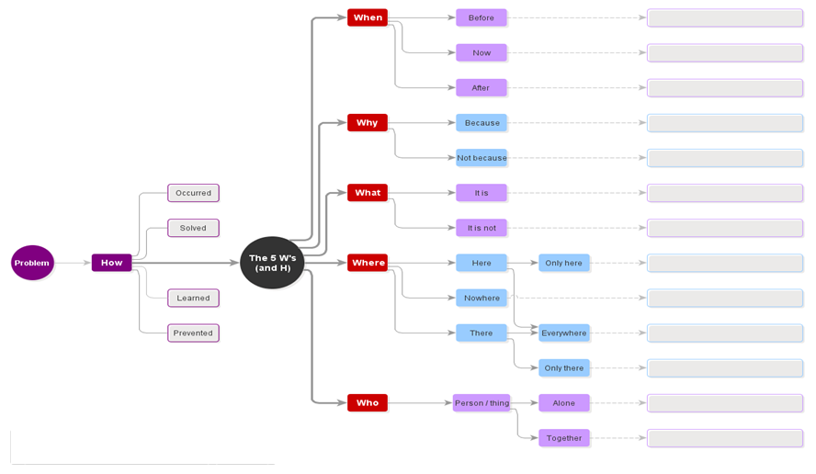
Approach

Slide 8
Systems Launched / Scheduled to be launched
IT has launched/scheduled to launch the below mentioned packages for the current financial year:
CMS (Courier management system)
OPS (One point solution)
Barcode System (Go down Management)
Sub store system
e-Tendering System
Medical Dispensary Automation.

Slide 9
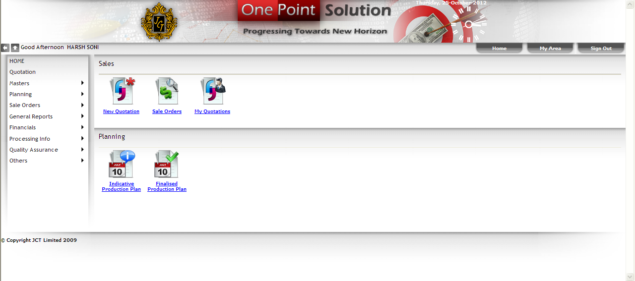
Objective
Objective of OPS is to bring the core information related to our organization available at a single platform.
It covers the untouched areas in the existing systems and provides the data to the user in a better way.
Wide area covered ranging from “procurement to payment receipt” has been covered in OPS.

Slide 10
Effective Departments & Motives
The departments having input screens and reports are as under:
Marketing
Planning
Logistics
Store
Accounts
Folding (Grey, Finish)
Costing
Quality Assurance
Development
Purchase & Logistics
HR & IR
Motives of OPS
To remove the gaps in the existing system.
To refine the current processes.
To generate user’s faith in the system provided data.
Ease in the analysis of data from staff to admin level.

Slide 11
Effective Departments & Motives
Overview
Various reports have been provided within the system, in a way to keep the executives up to date so that they can track their orders and can make ensure that the dispatches are on exact demanded time.

Slide 12
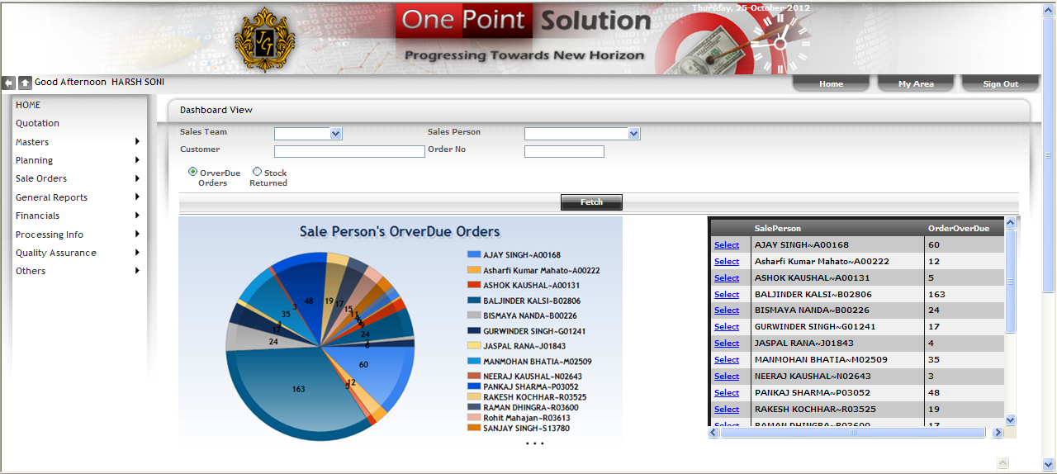
MIS/Analytical Reports
Major focus behind the development of the One Point Solution is to provide vital data in a way that it will help management in Analysis of performance given by various department.
MIS / Analytical reports
provided by OPS helps in
decision-making on
Long term planning, short
term planning and
budgeting

Slide 13
Future Plan
Costing
Inventory
Sales
MIS
RAMCO
OPS
Project Shikhar
Spinning
Finance & Accounting
Sizing
Weaving
Planning
Purchase
JCT FABRICS

Slide 14
Future Plan
We are continuously under process of understanding / Improving processes and documenting the same for future use. We will be fully prepared for the implementation of SAP as our processes documentation will be over within this financial year (2012-2013) and we will be conversant with all type of masters as well as transactions required for SAP implementation. For the smooth functioning of these packages, a lot of processes need to be changed. We need support from the management as well as the concerned departments to cover up these gaps.

Slide 15
THANK YOU
I would like to thank the management for giving us an opportunity to present ourselves.

